Slide 1

Robot Obstacle avoidance with reinforcement learning
Group Members:
Alexandre Dietrich
Ankur Tyagi
Haitham Alamri
Rodolfo Vasconcelos
Intelligent Systems and Reinforcement Learning

Slide 2
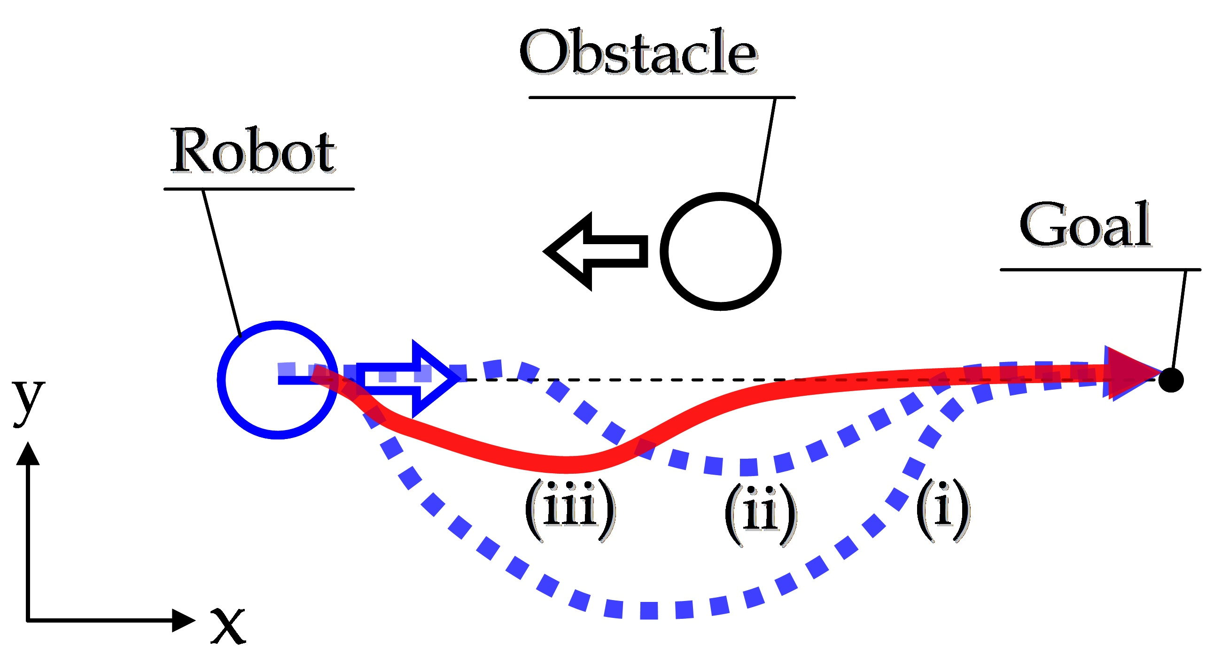
Problem Statement
Find the optimal path for robot to reach an end point (goal state) while avoiding randomly generated obstacles in a 2D space

Slide 3
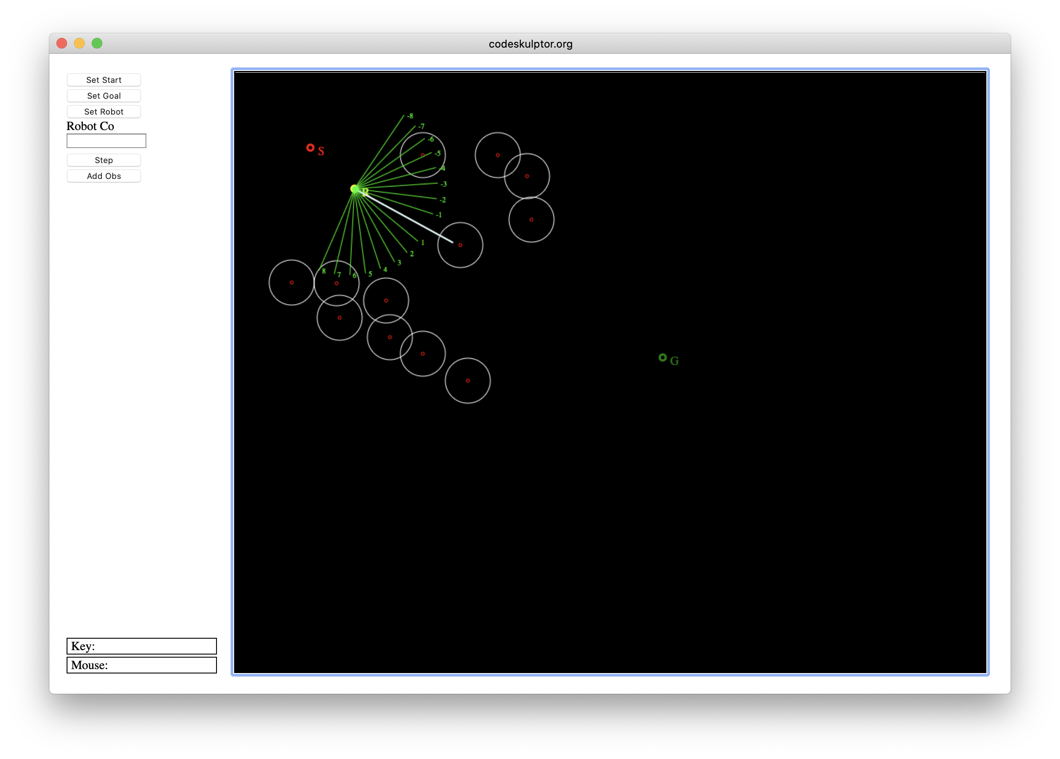
Environment
Environment simulation using python 3 for the project
Simulation Steps:
Choose the starting coordinates of the robot
Choose the target coordinates
Define static obstacles – generated randomly for each episode
Define number of sensors on the robot
Navigate the path using the step and avoid any incoming obstacles while navigating towards the target state.
Objectives:
Identify and optimize the algorithm to avoid the obstacle and reach the destination in least amount of steps
Compare the efficiency of algorithms against each other.
*sample screen shot

Slide 4
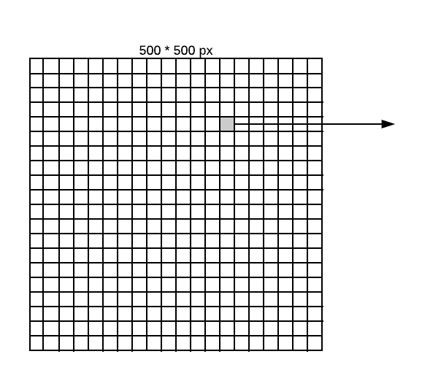
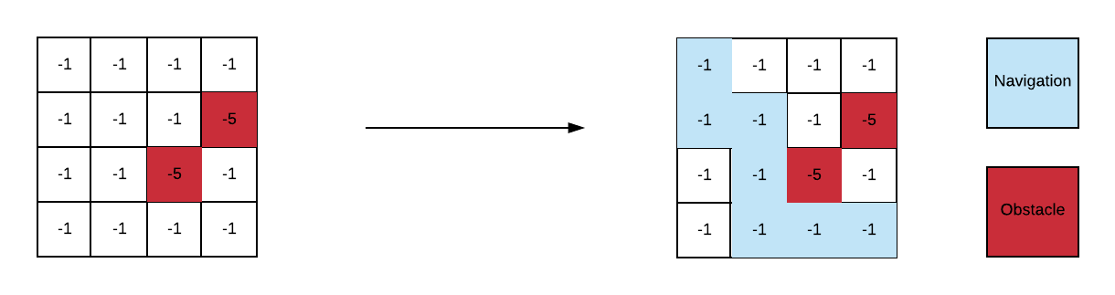
Solution Approach
Set the Canvas size to be 500*500 pixels Grid of 40*40 with each grid of 12.5 pixels Starting point : top corner(10,10) End point : bottom right corner (450, 450) Actions(s): Up, Down, Right and left | States: all possible states within a 4 x 4 grid with 0, 1 or 2 obstacles T(s'|s; a): probability of s0 if take action a in state s = 1 (No uncertainty) Reward(s; a; s0): -1 without obstacle, -5 when there is an obstacle 500
One grid - matrix with 2 possible obstacle

Slide 5
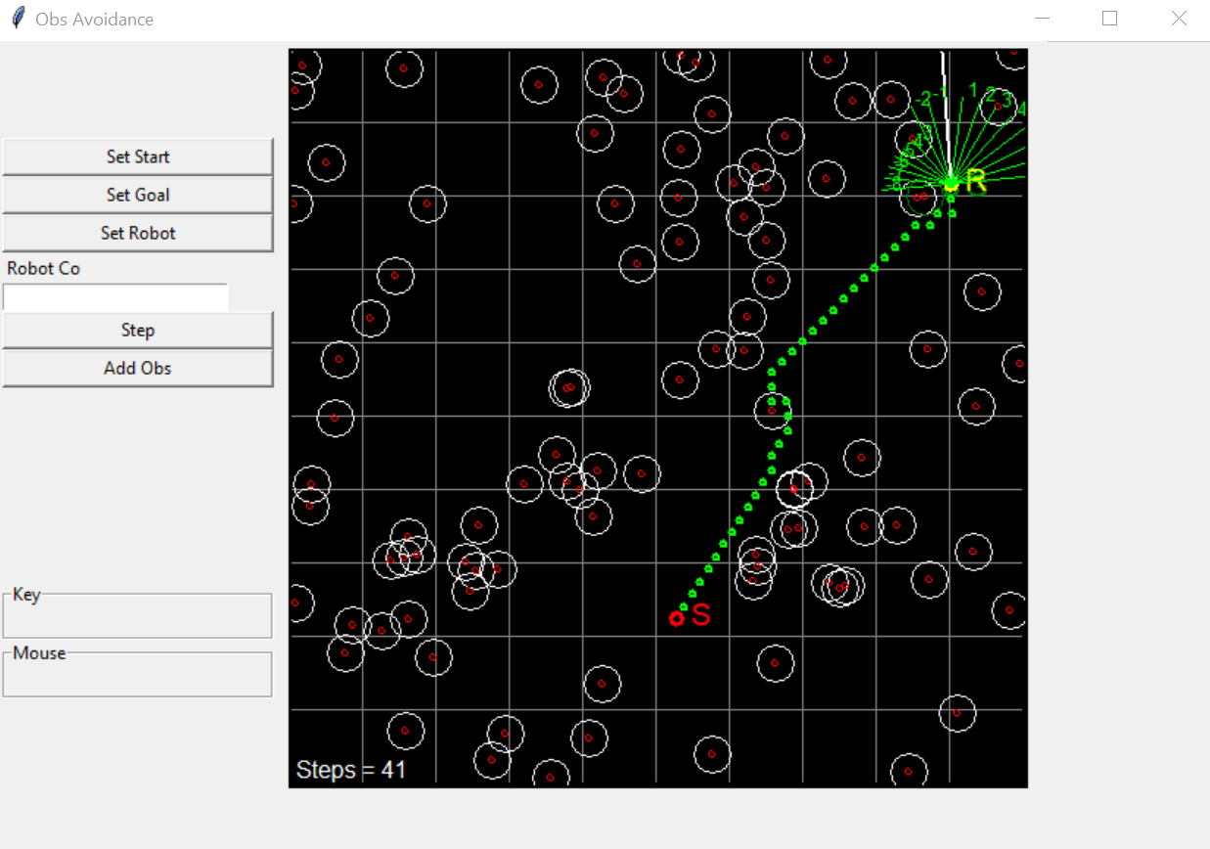
algorithm – 1 (static policy) : Bayesian + static
Assumptions:
500*500 pixels Starting point : top corner(10,10) End point : bottom right corner (450, 450) Actions(s): Up, Down, Right and left States: all possible states within a 4 x 4 grid with 0, 1 or 2 obstacles | T(s'|s; a): probability of s0 if take action a in state s = 1 (No uncertainty) Reward(s; a; s0): -1 without obsctacle, -5 when there is an obstacle Discount factor = 0.6
Sample policy : policy_key=(3, 0)|[]
---------------------------
-1.00|-1.00|-1.00|-1.00|
---------------------------
-1.00|-1.00|-1.00|-1.00|
---------------------------
-1.00|-1.00|-1.00|-1.00|
---------------------------
0.00|-1.00|-1.00|-1.00|

Slide 6
algorithm – 2 (Dynamic policy) - BAyesian
500*500 pixels Starting point : top corner(10,10) End point : bottom right corner (450, 450) Actions(s): Up, Down, Right and left States: all possible states within a 4 x 4 grid with 0, 1 or 2 obstacles | T(s'|s; a): probability of s0 if take action a in state s = 1 (No uncertainty) Reward(s; a; s0): -1 without obsctacle, -5 when there is an obstacle Discount factor = 0.6
Find the optimal path for robot to reach an end point (goal state) while avoiding randomly generated obstacles in a 2D space

Slide 7
algorithm – 3 (HyBrid - Bayesian and Dynamic policy)
500*500 pixels Starting point : top corner(10,10) End point : bottom right corner (450, 450) Actions(s): Up, Down, Right and left States: all possible states within a 4 x 4 grid with 0, 1 or 2 obstacles | T(s'|s; a): probability of s0 if take action a in state s = 1 (No uncertainty) Reward(s; a; s0): -1 without obsctacle, -5 when there is an obstacle Discount factor = 0.6
Find the optimal path for robot to reach an end point (goal state) while avoiding randomly generated obstacles in a 2D space

Slide 8
Performance Slides

Slide 9
Conclusion – Lesson Learnt and future work
Find the optimal path for robot to reach an end point (goal state) while avoiding randomly generated obstacles in a 2D space

